Slide 1

The Drive By Project
Software Manager: Dirk Thieme
Hardware Manager: Erik Manis
Project Controller: Mohammed Ansari

Slide 2
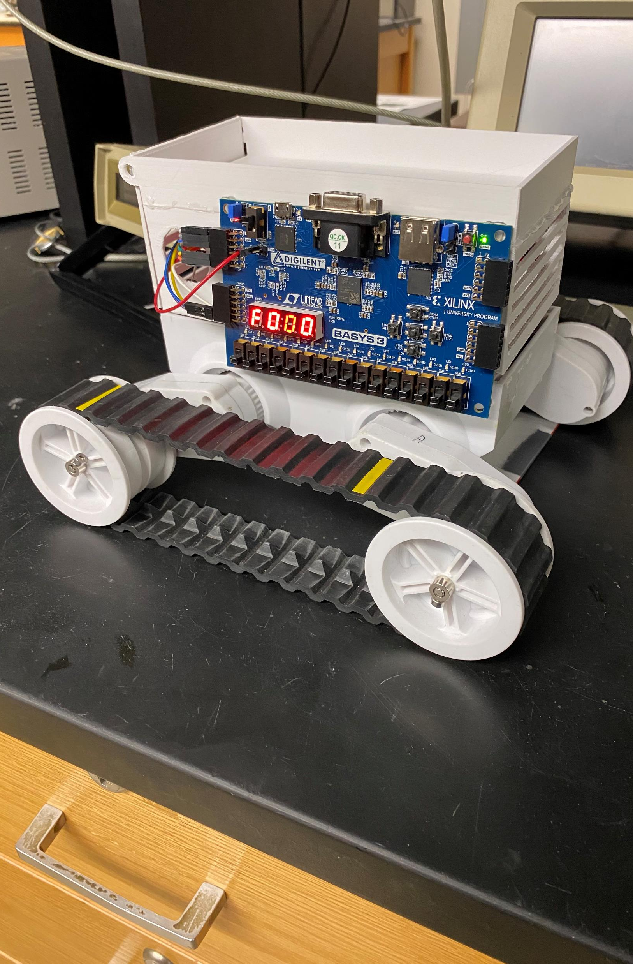
The Project Description & Objectives
Using a BASYS board, H bridge board and sensors to make a rover move along a metallic path and identify friendlies and hostiles along its path while also shooting the enemies by firing rubber bands at them

Slide 3
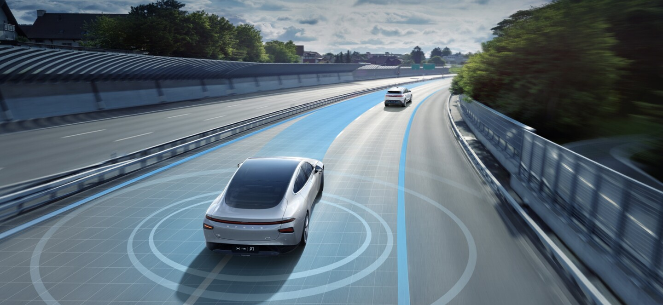
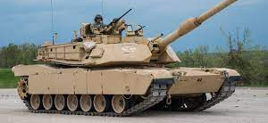
Project Opportunity
Military use : The rover’s capability could be enhanced to rival that of a military tank by improving the armor and the weapon placed on top of it
Self driving : The rover’s IR sensor could be replaced with other sensors that could track the path a self driving car would have to go on. The phototransistors could also be replaced with something that would detect other stuff that is close to the vehicle

Slide 4
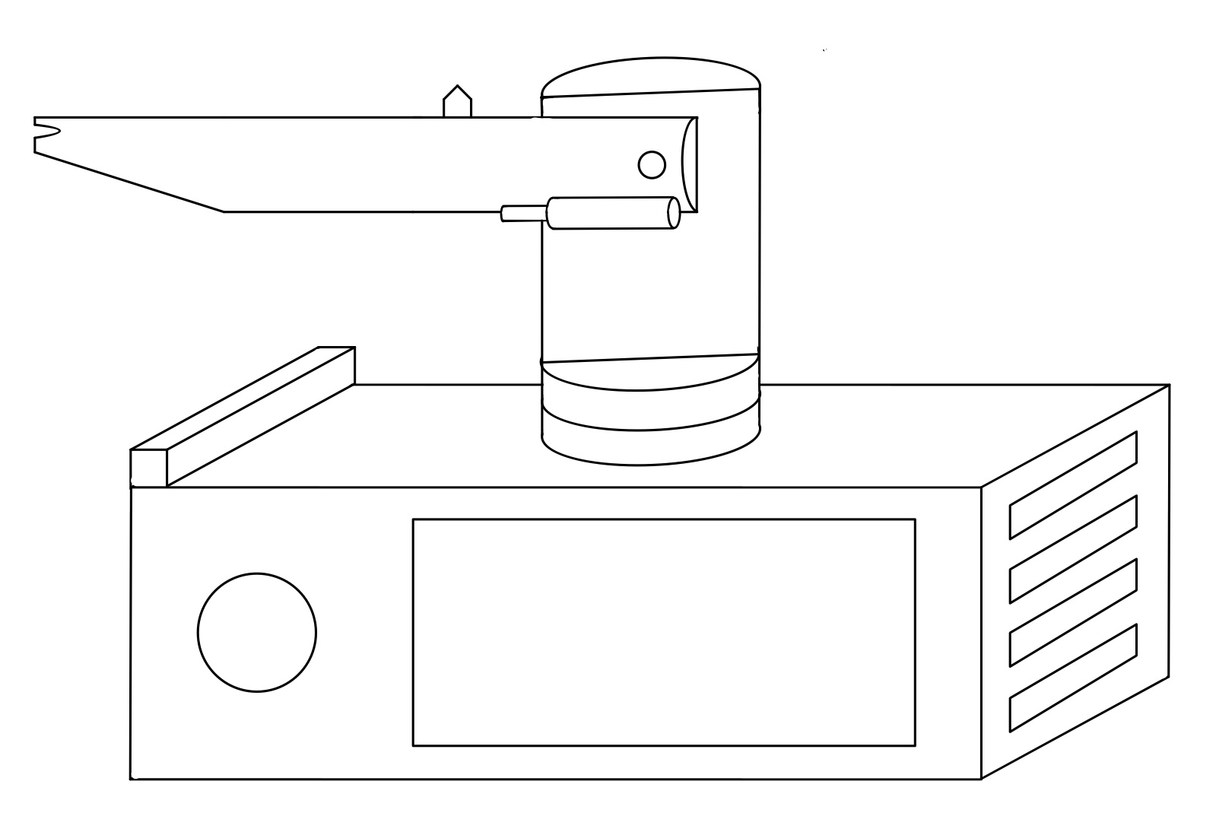
Project Sketch

Slide 5
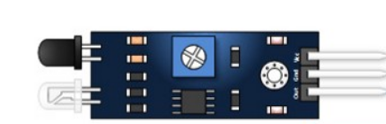
Hardware | HW-201 IR Sensor
It consists of an IR emitter which emits the signal and an IR receiver which detects the reflected signal
The IR receiver has a range from 2cm to 30 cm and is adjustable with a potentiometer
It has a 35-degree Detection Angle
It operates at a DC voltage range of 3.3V – 5V

Slide 6
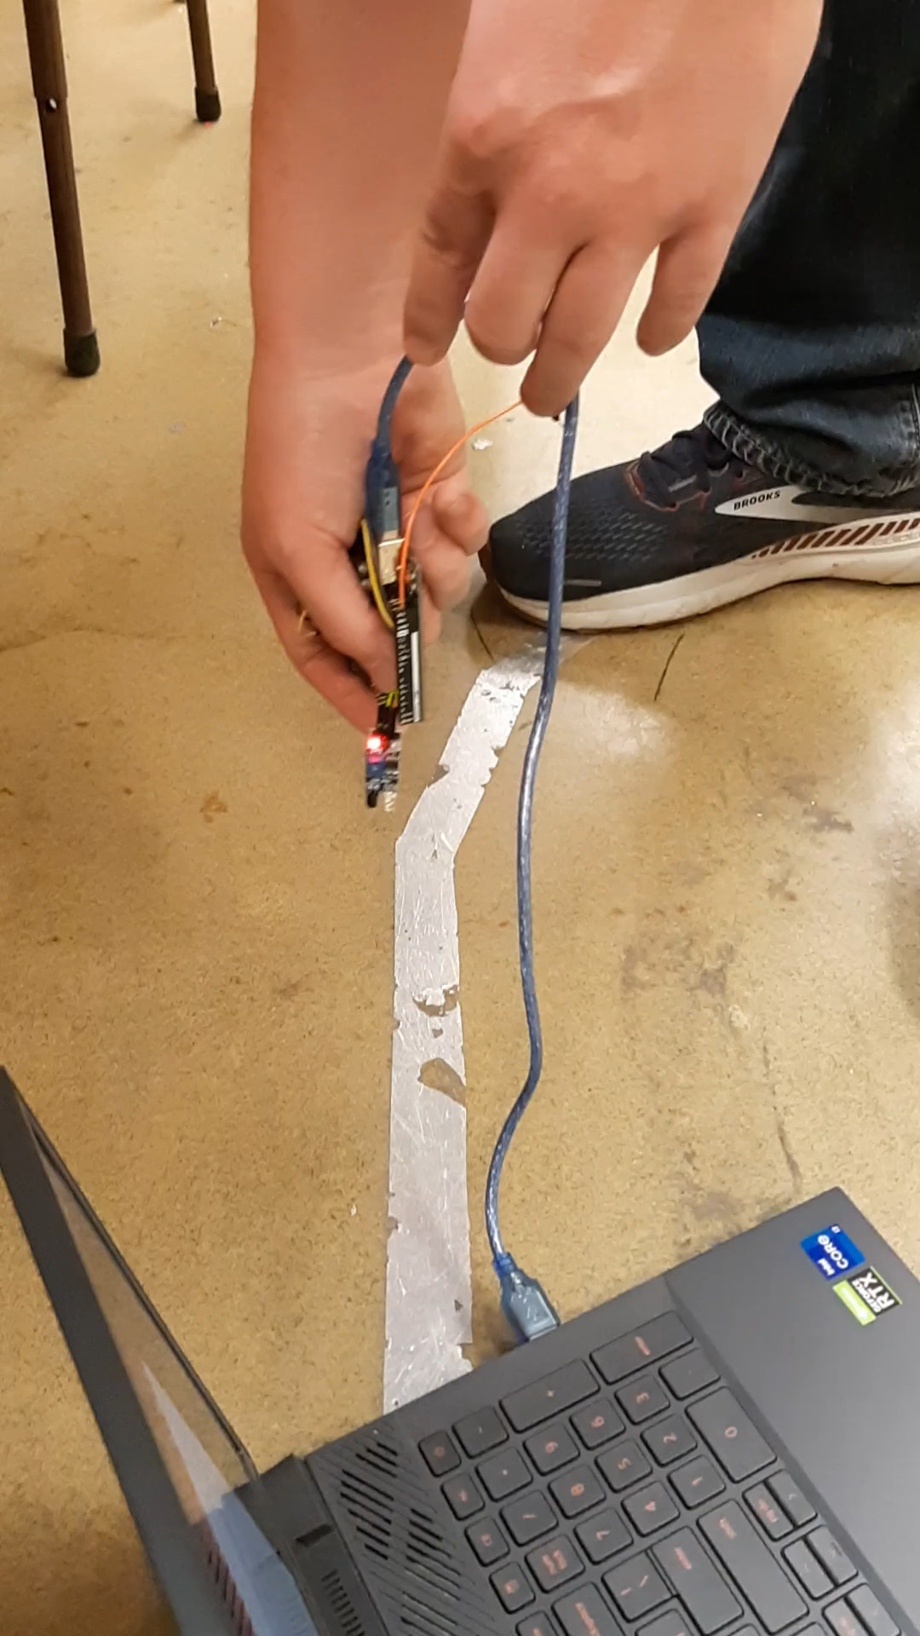
Hardware

Slide 7
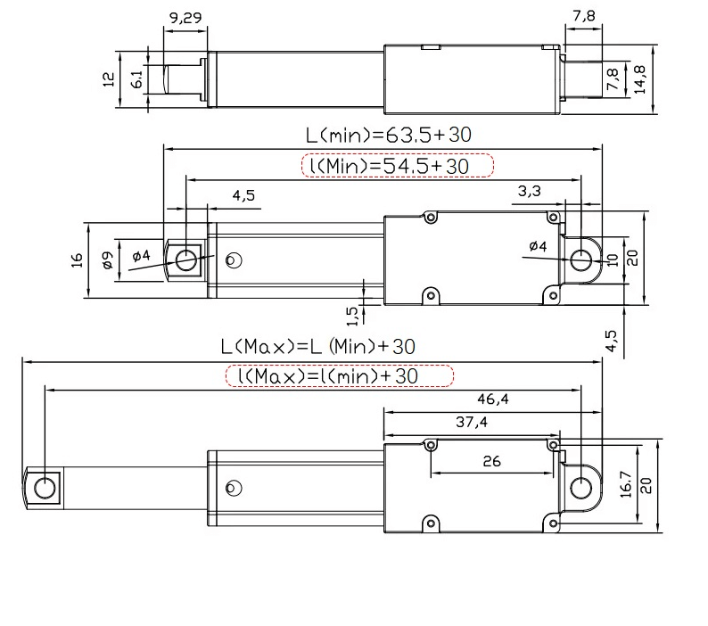
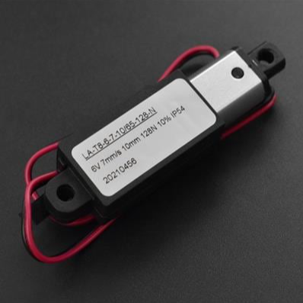
Hardware
6V Actuator

Slide 8
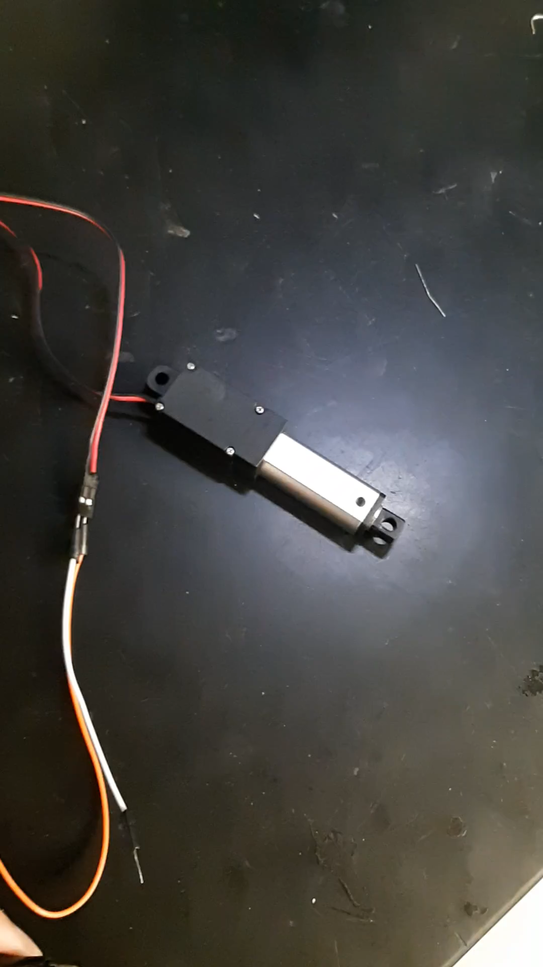
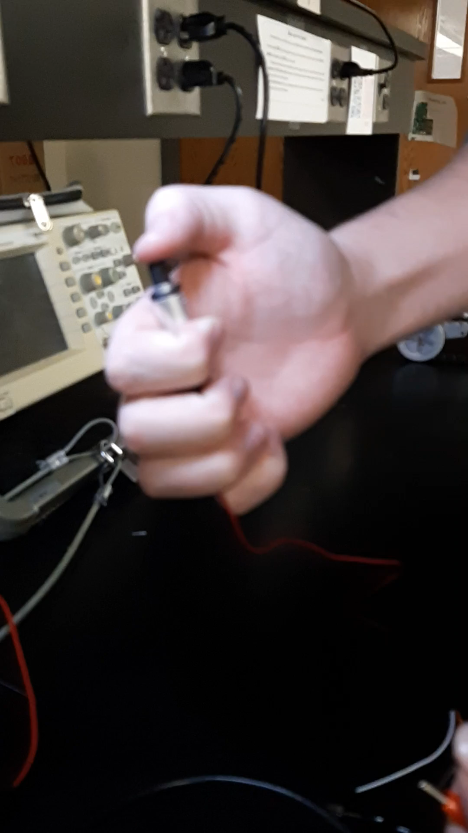
Hardware
6V Actuator

Slide 9
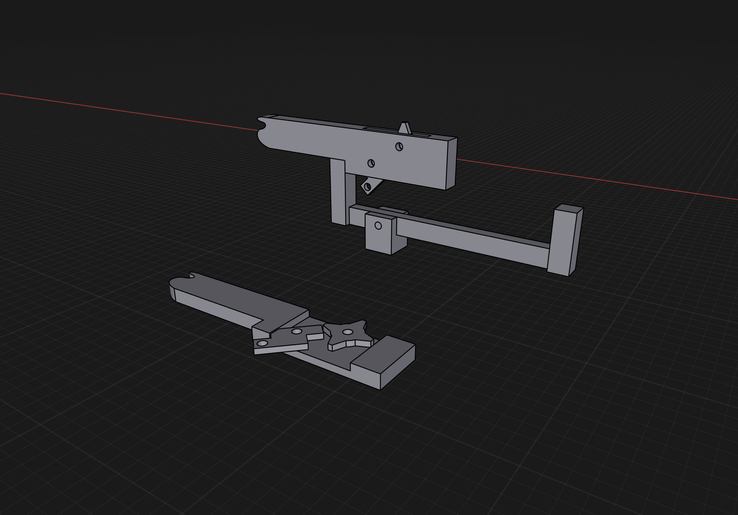
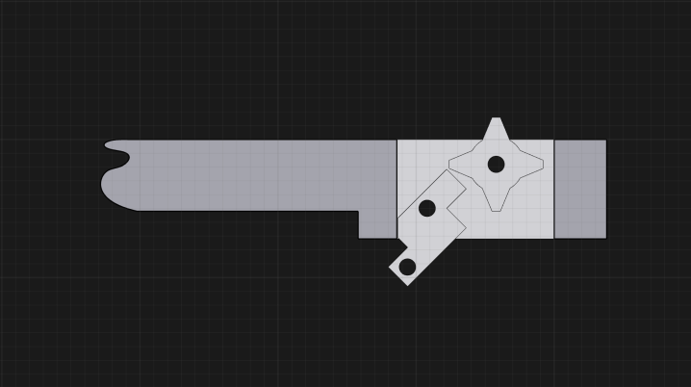
Hardware
3D Models

Slide 10
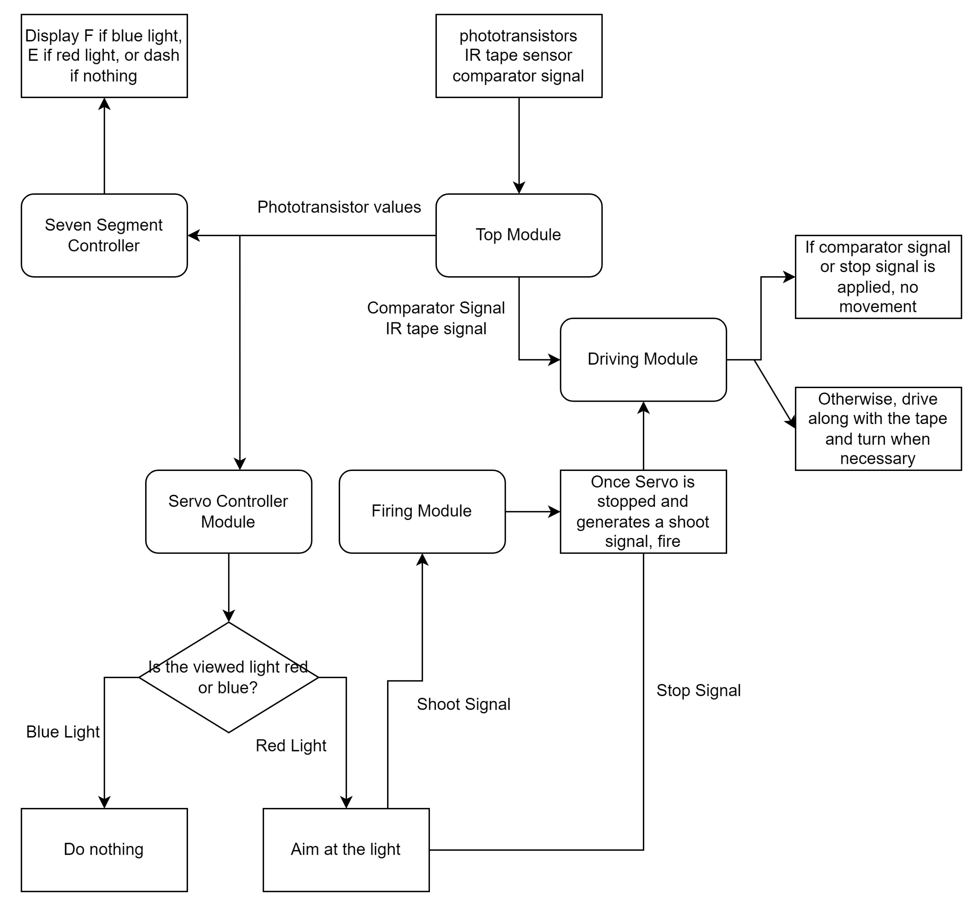
Software

Slide 11
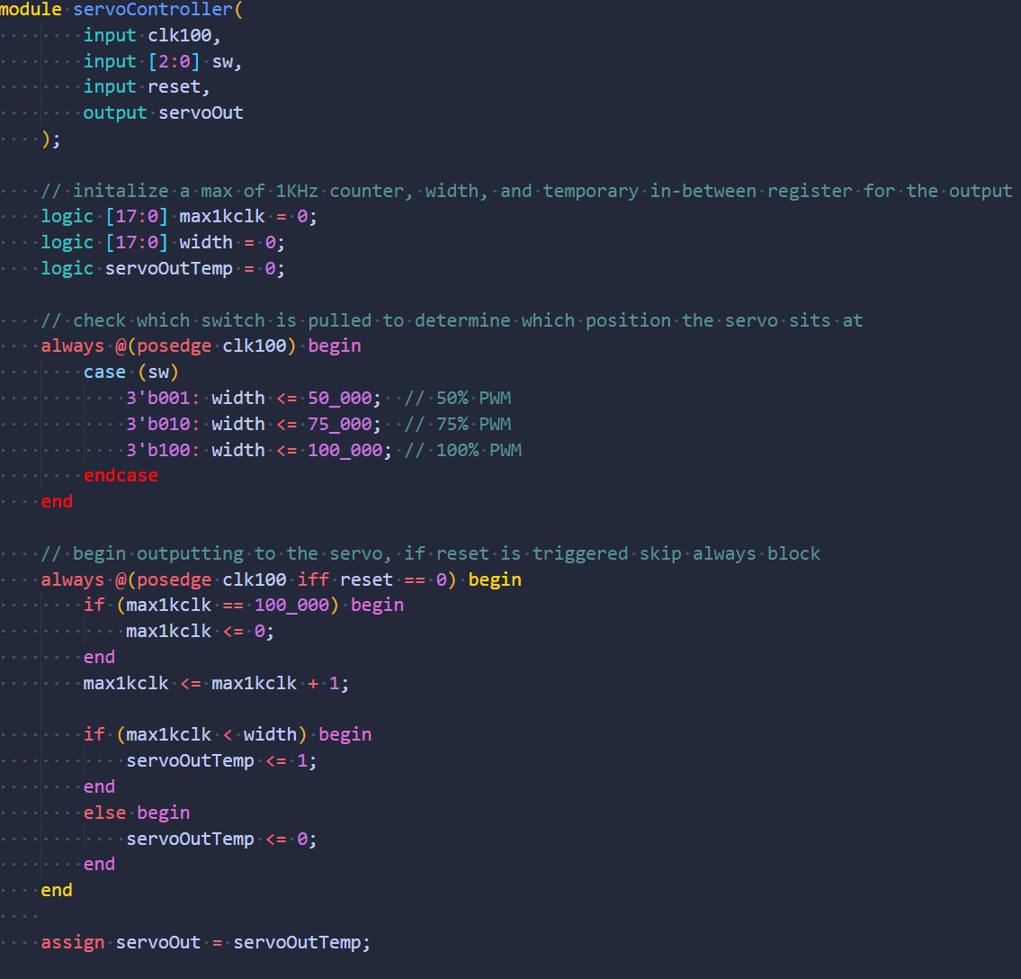
Software
Servo Controller

Slide 12
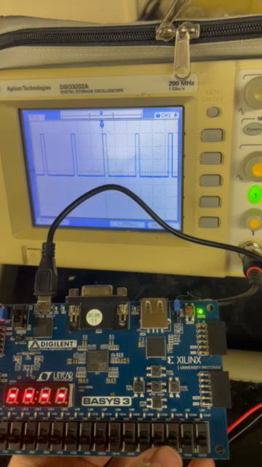
Software
Servo Test

Slide 13
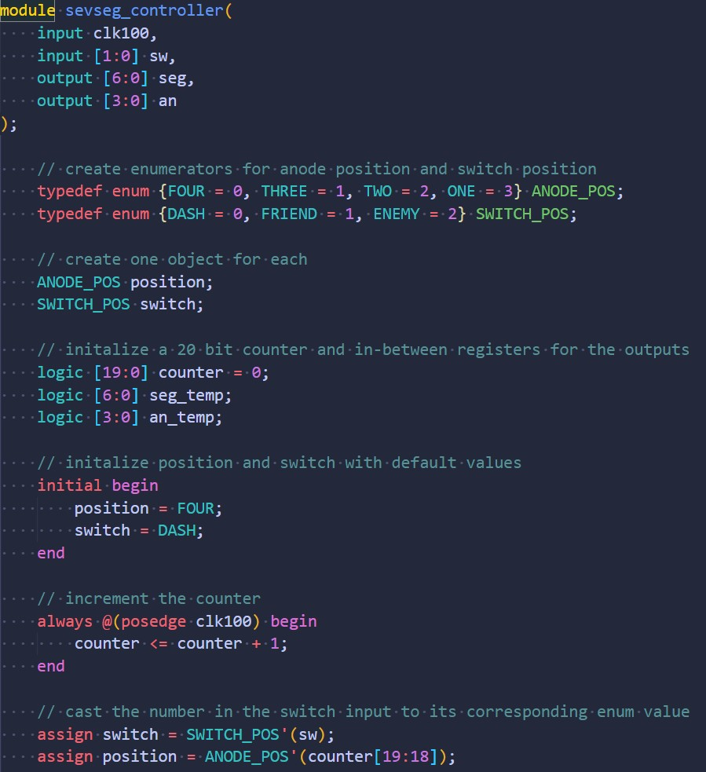
Software
Seven Segment Display pt. 1

Slide 14
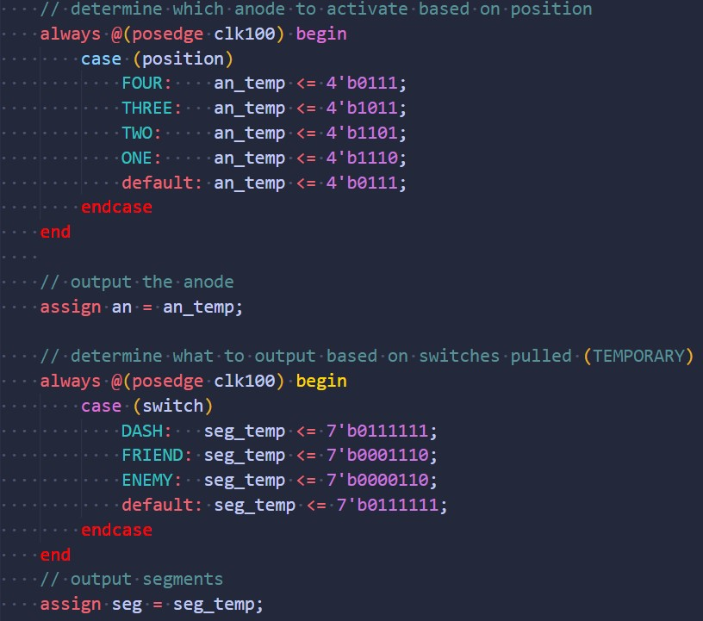
Software
Seven Segment Display pt. 2

Slide 15
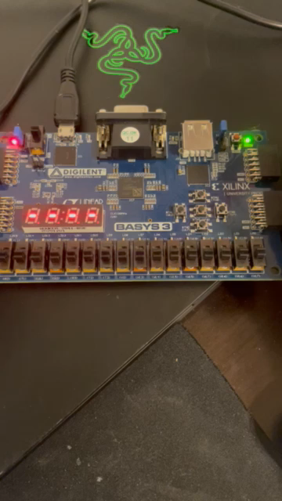
Software
Seven Segment Test

Slide 16
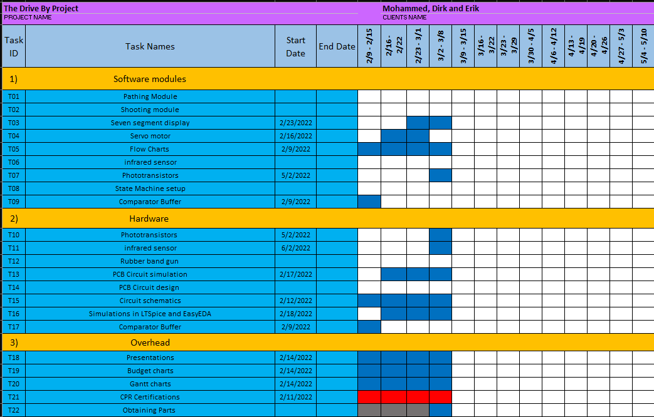
Gantt

Slide 17
Overall Budget

Slide 18
Labor Hours and Material costs

Slide 19

Questions
Software Manager: Dirk Thieme
Hardware Manager: Erik Manis
Project Controller: Mohammed Ansari
This Photo by Unknown author is licensed under CC BY.

